Slide 1
3rd edition of the inter-school competition INNOVATHON: IA for Sustainable Racing
From Mai 15, 2024 until July 19, 2024

Slide 2
1. Plan
01
Context of the competition
03
Competition’s Milestones
Autonomy levels
04
Technical specifications
02
06
05
Engineering schools liste
Budget

Slide 3
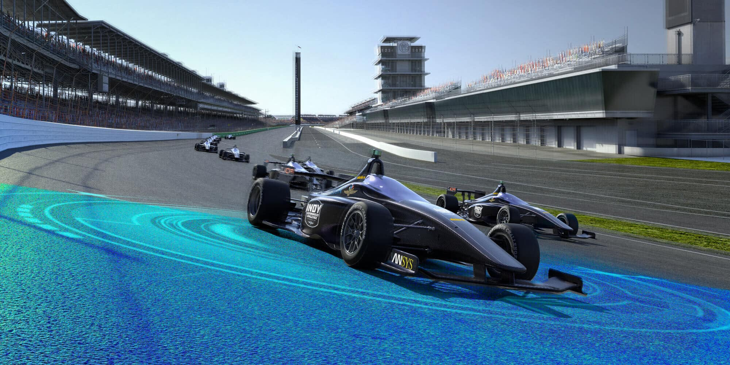
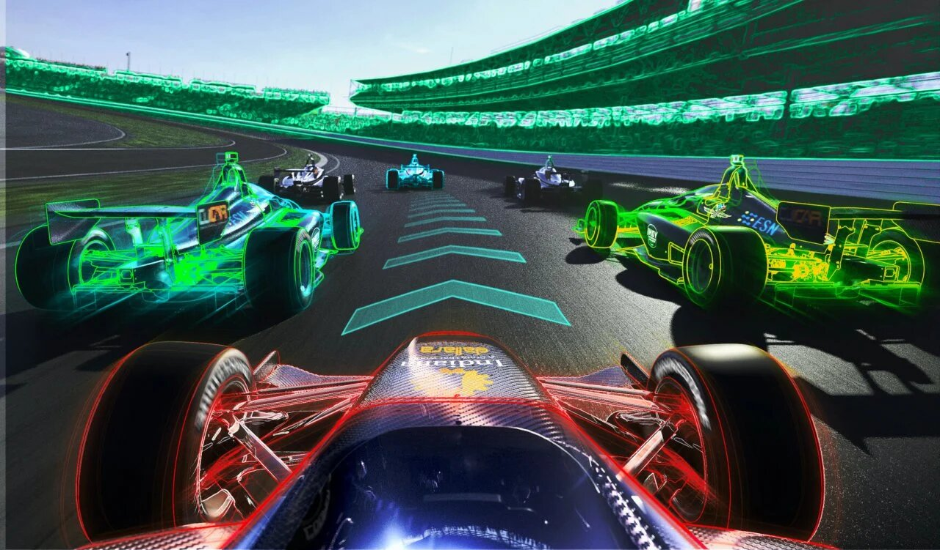
1. Context
s
s
s
1 Contexte
Given the transition to autonomous vehicles and the great interest that this notion brings to major automobile manufacturers, and in this context Capgemini engineering is committed to contributing to technological development, after the great success of the second edition in 2023. Capgemini Engineering is launching the 3rd edition of the inter-school competition under the subject :
s
s
«IA for Sustainable Racing»
This competition is open to all enthusiasts of intelligent mobility with an interest in mechanical sports (racing) looking to resolve the challenges linked to autonomous vehicles equipped with AI programs through realization of a DEMO , to develop their technical skills and demonstrate their spirit of innovation in a competitive environment.

Slide 4
2. Autonomy target level
s
s
s
1 Contexte
The objective of the competition is to evaluate the compliance with level three of autonomy requirements with the completion of the “Driving a racing vehicle with AI” challenge:
s

Slide 5
3. Competition’s Milestones
Phase 5: Competition Final
July 19, 2024.
Location: ENSEM / UIC
Phase 4: Realization
From June 14 to July 19 with weekly monitoring and support by Capgemini Engineering.
Phase 3: Design
From May 21 to June 14 with qualification of 10
Teams, Coaching sessions: (Project management, technical training: AI, autonomous vehicles, python, mechanical design).
Phase 2: Kick off
Overall presentation of the competition from May 20 until May 21.
Phase 1: Call for applications
From May 15 until May 17 through a form.

Slide 6
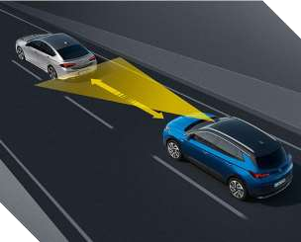
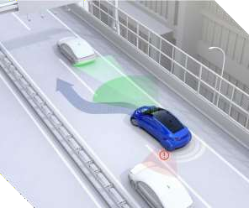
4.Technical specifications
4.1. Design phase
Illustration des systèmes ADAS & AI
ACC: Adaptive Cruise Control
LCA: Lane changing assist
Each team made up of 3 to 5 students must respect the following conditions of participation:
During the design phase each team must submit a technical file according to the list below:
A complete functional analysis.
A GANT schedule.
A list of hardware needed to deploy the functions
(justifying the choice of materials).
Lane Keeping assist & making a 120-degree turn
The characteristics of the chosen electric vehicle: dimensions (width < 18 cm), power and power supply type.
The justification for the chosen AI learning methods and the tools used.
The program relating to the use case must be written and compiled.
Preliminary AI learning results (optional).

Slide 7
4.Technical specifications
4.2. Demo phase
The production phase: programming a prototype of an autonomous vehicle based on the technical file developed during the design phase.
Winners' selection criteria:
Quality of the documentation provided during the design phase.
Timing: the time required to complete the defined circuit.
Exploitation of a renewable energy source (ex: photovoltaic cell).
Level of autonomy reached (Any means of remote assistance is prohibited).
Presentation and highlighting of the project.
Teamwork.
Choice of environmentally friendly materials.
The prototype must be capable of making a 120° turn.
The prototype must meet the three main use cases using AI:
> Adaptive Cruise Control.
> Lane Changing Assist.
> Lane Keeping Assist.
Strat
Finish

Slide 8
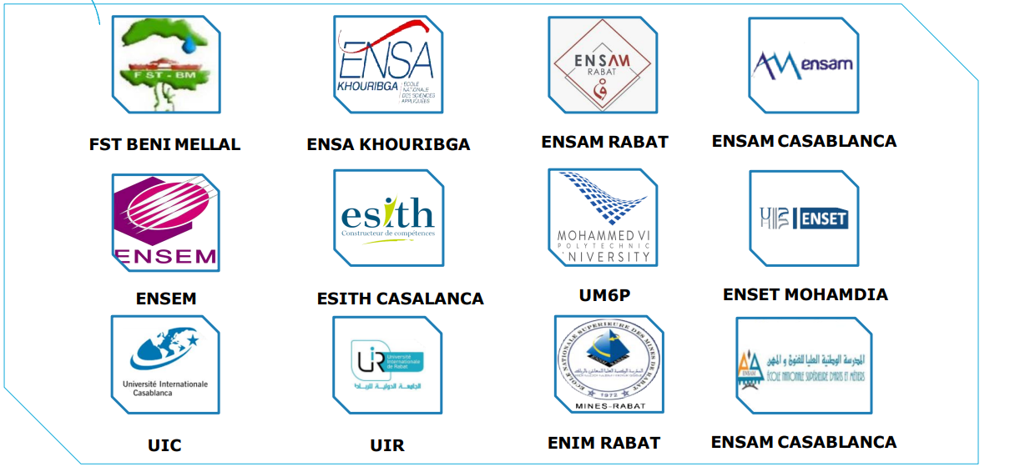
5. Engineering schools liste

Slide 9
For more information:
About Capgemini
Capgemini is a global leader in partnering with companies to transform and manage their business by harnessing the power of technology. The Group is guided everyday by its purpose of unleashing human energy through technology for an inclusive and sustainable future. It is a responsible and diverse organization of 270,000 team members in nearly 50 countries. With its strong 50-year heritage and deep industry expertise, Capgemini is trusted by its clients to address the entire breadth of their business needs, from strategy and design to operations, fuelled by the fast evolving and innovative world of cloud, data, AI, connectivity, software, digital engineering and platforms. The Group reported in 2020 global revenues of €16 billion.
Get the Future You Want | www.capgemini.com
Contact the ROBOTIC Club or the Networking with schools Club
This presentation contains information that may be privileged or confidential and is the property of the Capgemini Group.
Copyright © 2024 Capgemini. All rights reserved.

